Slide 1


Final Project Working with Data Using Python
Akwasi Afriyie
Esteban Omar Rosero Romero
Mateo Hidalgo Prada
Yarazeth Garcia Ibarra
Koichiro Suzuki

Slide 2
Introduction
The aim of this project is to undertake sentiment analysis using Python on a dataset of 142.8 million reviews for 212404 unique books on Amazon between 1996 and 2014.
It involves analyzing two data files, one for book reviews and one for book details, with various features such as book title, price, review rating, and full review text.
Task one requires a brief explanation of text mining, text classification, text clustering, and sentiment analysis.
The second task involves data cleansing, classification, and word clouds to generate analytical visualizations. It includes classifying reviews into positive and negative sentiment categories and generating corresponding word clouds.
The third task involves building both a simple and multinomial logistic regression models to predict the sentiment category and rating of a book based on its text-based review.

Slide 3
BRIEF EXPLANATION OF TERMS
Text Mining:
Text Mining is the extraction of useful and meaningful information from large amounts of unstructured or semi-structured text data. It involves techniques such as natural language processing, machine learning, and data mining to identify patterns, extract key terms, and categorize text into different topics or themes. The goal of text mining is to turn raw text into valuable insights that can inform business decisions, scientific research, and other areas of study.
Text Classification:
Text Classification is the process of categorizing text data into predefined categories or classes based on their content. It is a supervised machine learning task where the system is trained on a set of labeled text examples and uses this training data to classify new text data into the appropriate categories. Some common applications of text classification include sentiment analysis, spam detection, and news categorization.

Slide 4
BRIEF EXPLANATION OF TERMS
Text Clustering:
Text Clustering is an unsupervised machine learning task where the system groups similar text documents into clusters without the use of predefined categories. The goal of text clustering is to identify underlying structures or themes in large collections of text data. Clustering algorithms can be used to identify topics, patterns, and relationships in text data, which can provide valuable insights and help to better understand the content.
Sentiment Analysis:
Sentiment Analysis is the process of determining the sentiment or emotion expressed in a text document, such as positive, negative, or neutral. It is a subfield of text classification and involves the use of natural language processing and machine learning techniques to analyze text data and determine the underlying sentiment. Sentiment Analysis is commonly used in customer feedback analysis, marketing research, and political analysis to understand public opinions and sentiment towards specific products, brands, or events.

Slide 5

Data Cleansing, Classification, and Word Clouds.

Slide 6
Variable analysis
---Books data---
#Get a concise summary of the dataframe.
df_data.info()
#Check for the number of null values for each variable. df_data.isnull().sum()
Data columns (total 10 columns):
# Column Non-Null Count Dtype
--- ------ -------------- -----
0 Title 212403 non-null object
1 description 143962 non-null object
2 authors 180991 non-null object
3 image 160329 non-null object
4 previewLink 188568 non-null object
5 publisher 136518 non-null object
6 publishedDate 187099 non-null object
7 infoLink 188568 non-null object
8 categories 171205 non-null object
9 ratingsCount 49752 non-null float64
dtypes: float64(1), object(9)
memory usage: 16.2+ MB
Title 1
description 68442
authors 31413
image 52075
previewLink 23836
publisher 75886
publishedDate 25305
infoLink 23836
categories 41199
ratingsCount 162652
dtype: int64

Slide 7
Variable analysis
--Books Ratings---
#Get a concise summary of the dataframe.
df_rating.info()
#Check for the number of null values for each variable. df_rating.isnull().sum()
Data columns (total 10 columns):
# Column Dtype
--- ------ -----
0 Id object
1 Title object
2 Price float64
3 User_id object
4 profileName object
5 review/helpfulness object
6 review/score float64
7 review/time int64
8 review/summary object
9 review/text object
dtypes: float64(2), int64(1), object(7)
Id 0
Title 208
Price 2518829
User_id 561787
profileName 561886
review/helpfulness 0
review/score 0
review/time 0
review/summary 38
review/text 8

Slide 8
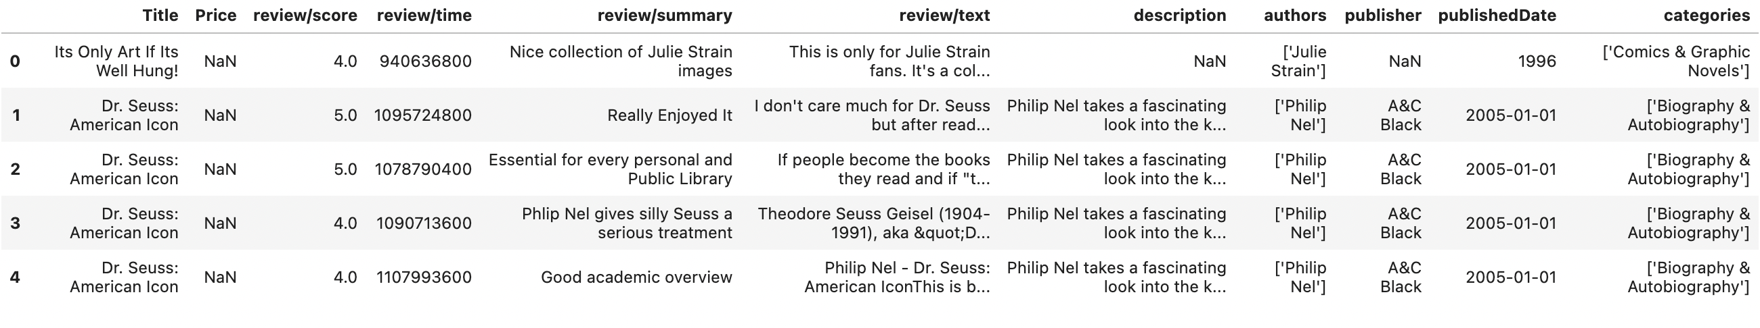
Merging Data
#Delete variables that are irrelevant to the creation of the predictive model
df_data.drop(columns=['image', 'previewLink','infoLink','ratingsCount'], inplace=True)
df_rating.drop(columns=['Id', 'User_id','review/helpfulness','profileName'], inplace=True)
#Do Margin-left Books data to Rating data via 'Title' column.
df=pd.merge(df_rating, df_data, on='Title', how='left')

Slide 9
Treating missing values
# There were 2518829 missing values for 'Price' in 'Book ratings’. Those missing values were replaced with the average value of 'Price'.
df['Price']=df['Price'].fillna(df['Price'].mean())
Title 208
Price 0
review/score 0
review/time 0
review/summary 38
review/text 8
description 640225
authors 390634
publisher 782617
publishedDate 354581
categories 551498
dtype: int64
#No more missing values for ‘Price’

Slide 10
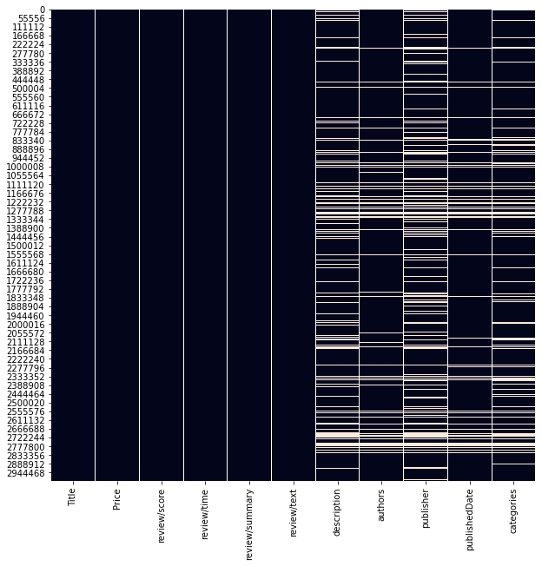
The following graph shows the distribution of missing values in the data.

Slide 11
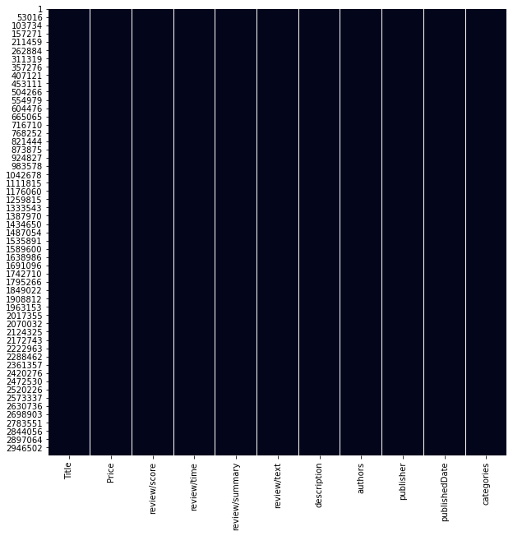
All the missing values were removed
df=df.dropna()
#As a result, 2071176 data remained.

Slide 12
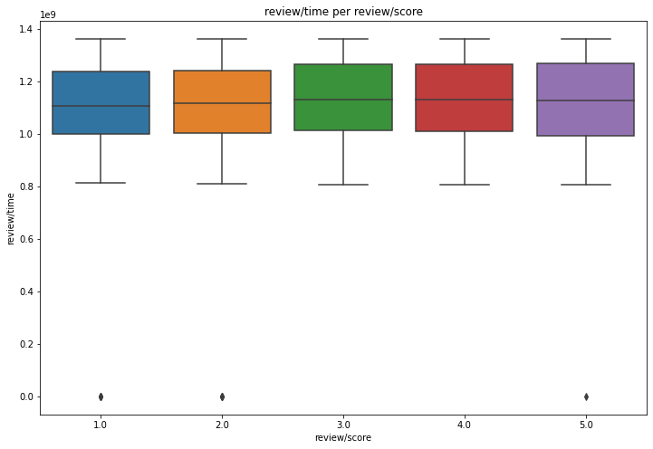
Treating outliers
This graph shows the 'review/time per review/score’.
And the existence of outliers in ‘review/time’

Slide 13
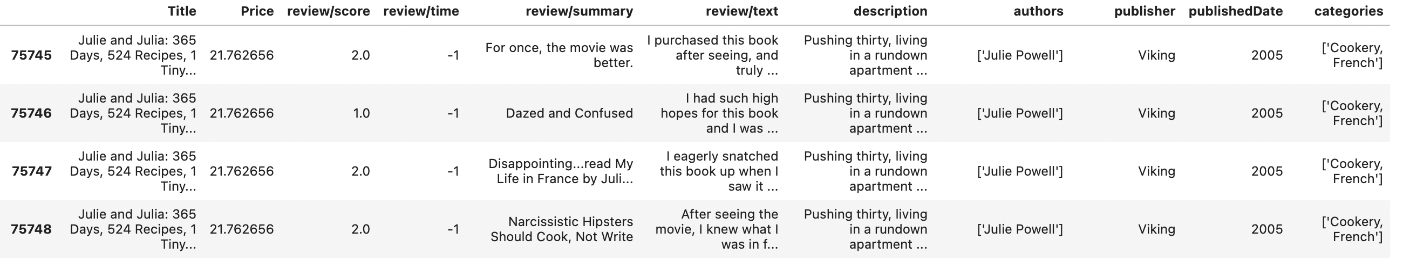
Treating outliers
#After checking the outliers in 'review/time’ there were "-1” values.
#Those values were removed
df=df[df['review/time'] != -1]

Slide 14
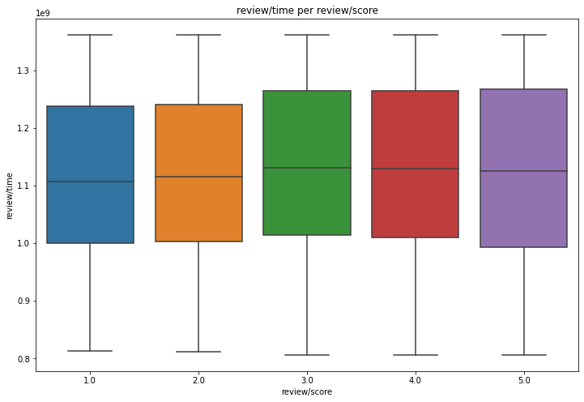
Treating outliers
This graph shows that there´s no more outliers in 'review/time’.

Slide 15
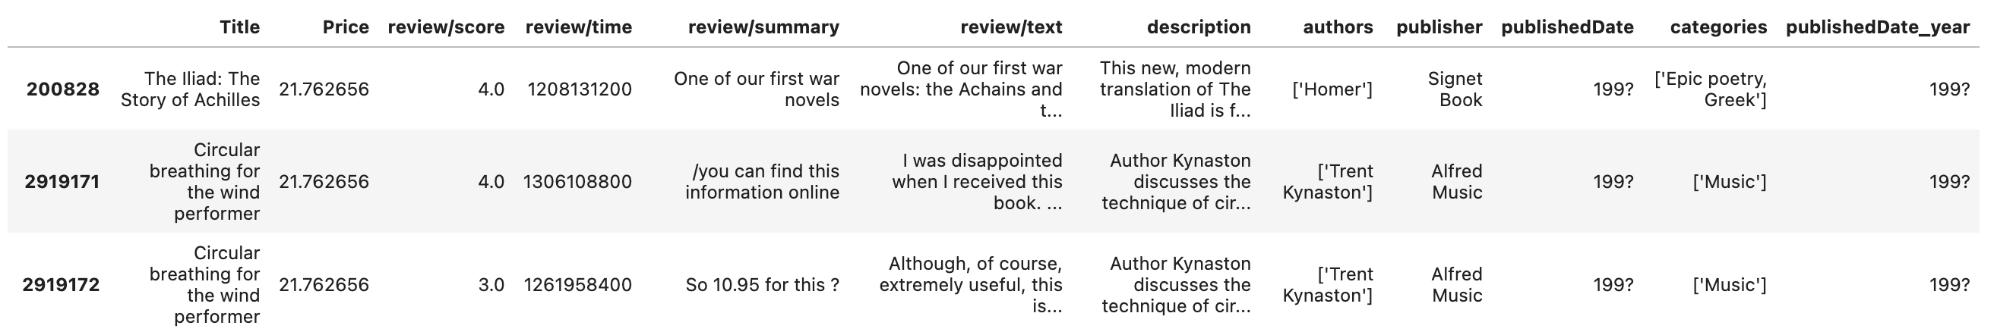
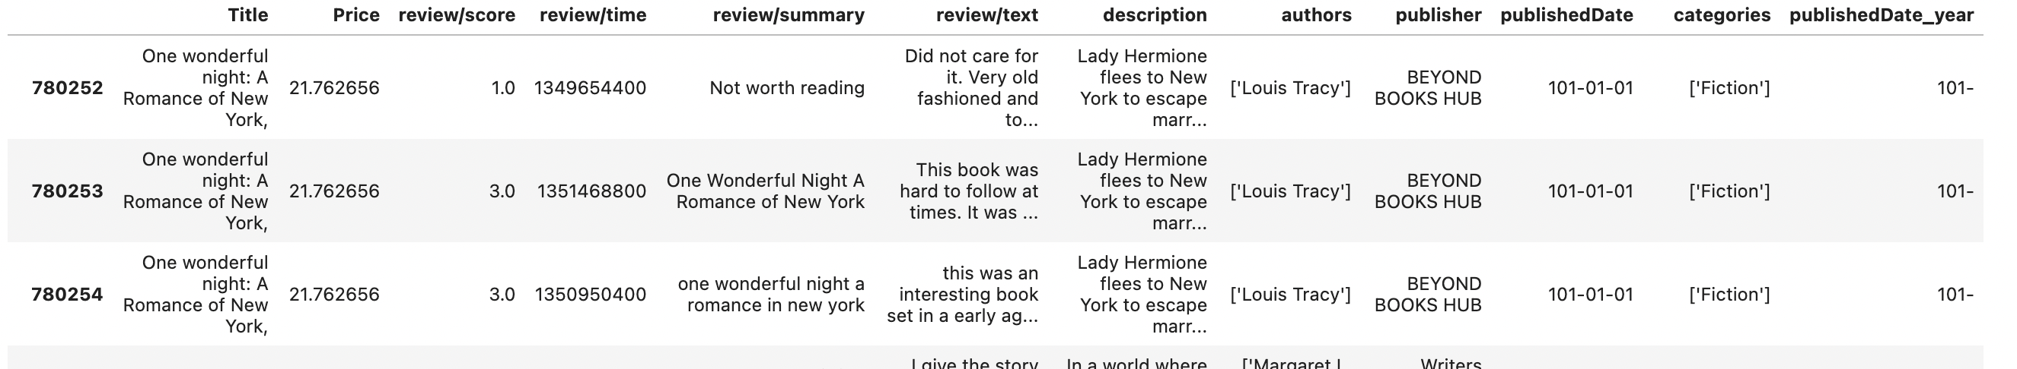
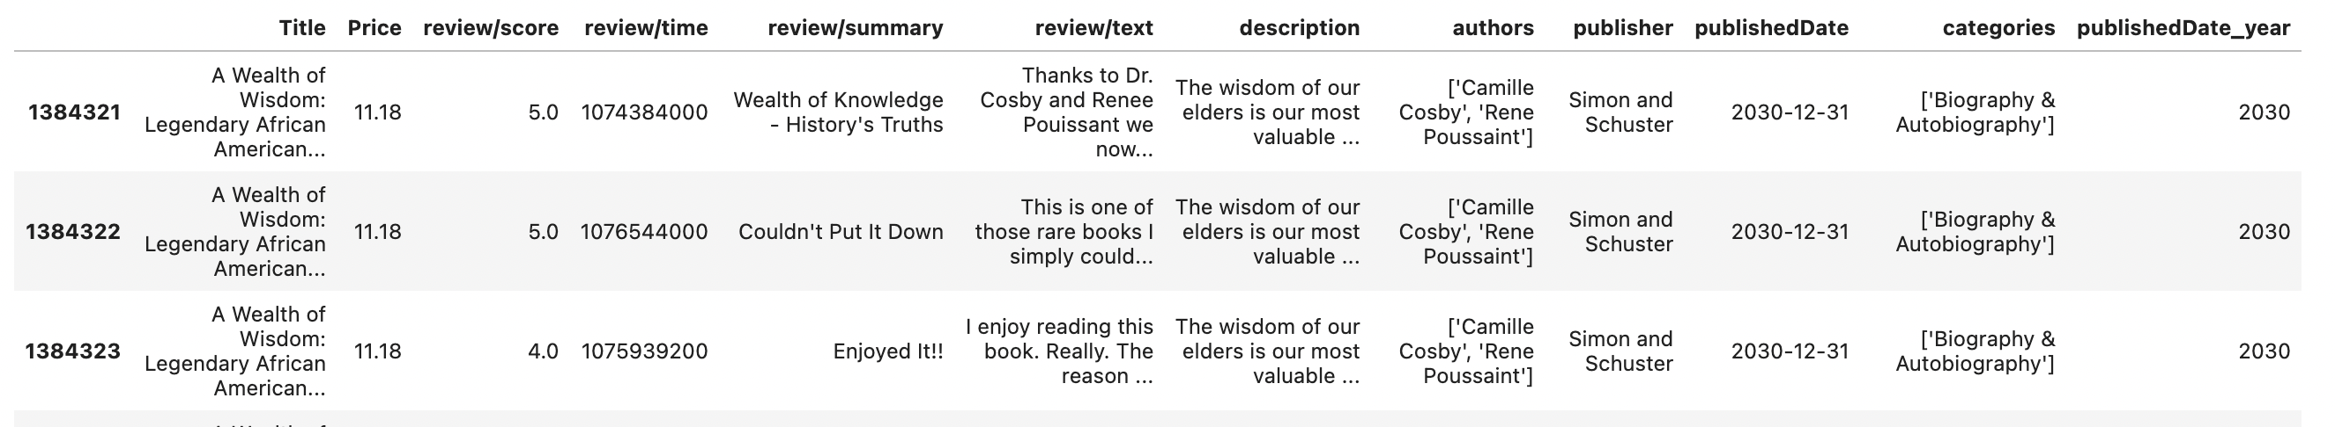
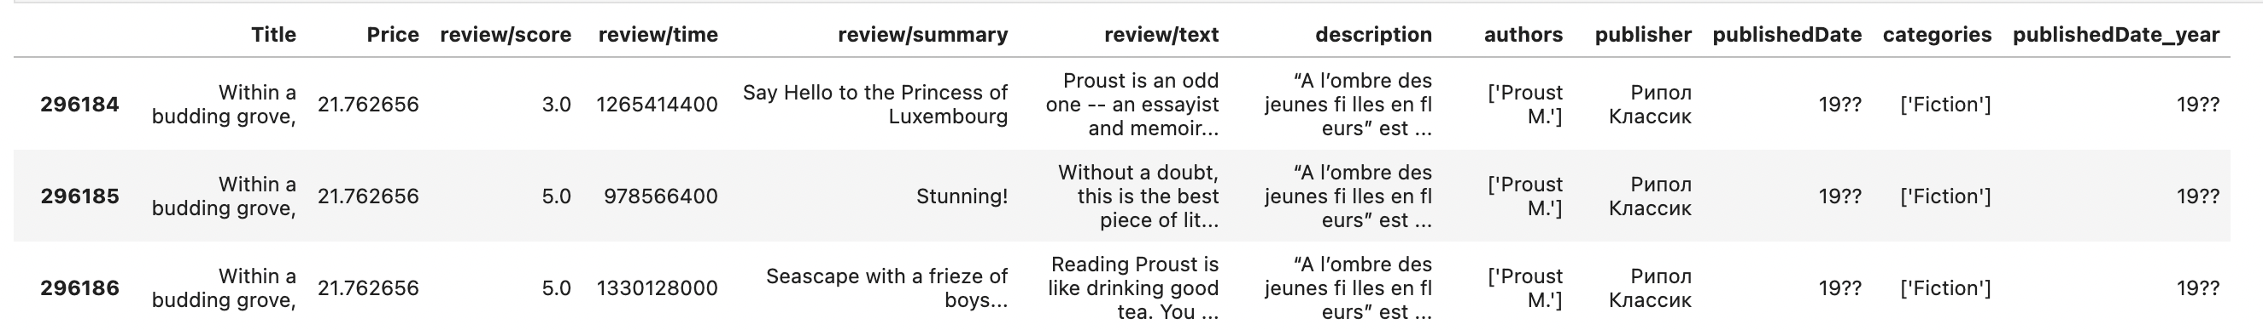
Treating outliers
In the variable "publishedDate”, there were multiple abnormal values
"199?"
"101-"
"2030"
"19??"

Slide 16
Treating outliers
A new column named 'publishedDate_year’ was created with only the year taken from 'publishedDate’.
df['publishedDate_year']=df['publishedDate'].str[:4]
Irregular values "19??", "199?","101-","2030" were removed
df=df[df['publishedDate_year'] != '101-']
df=df[df['publishedDate_year'] != '2030’]
df=df[df['publishedDate_year'] != '199?’]
df=df[df['publishedDate_year'] != '19??']

Slide 17

Generate initial analytical visualizations to understand the reviews

Slide 18
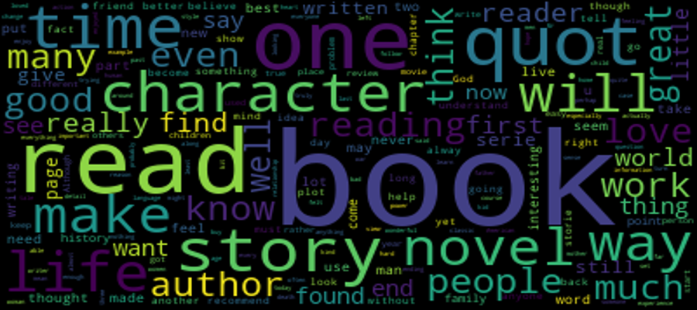
Visualize the words that are often included in 'review/text' using a word cloud.
#(10000 samples) df_rating_sample10000=df.sample(n=10000)
#Create stopword list stops= set(STOPWORDS)

Slide 19
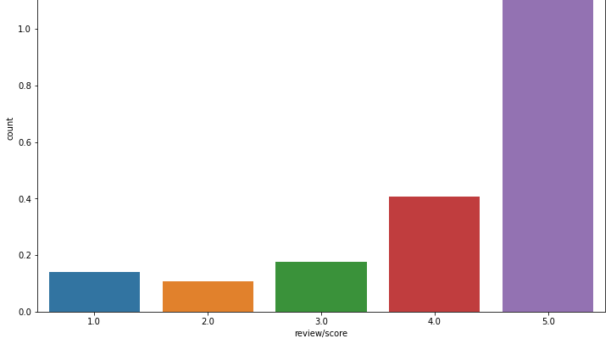
Le6
Display of the number of data per review score.

Slide 20
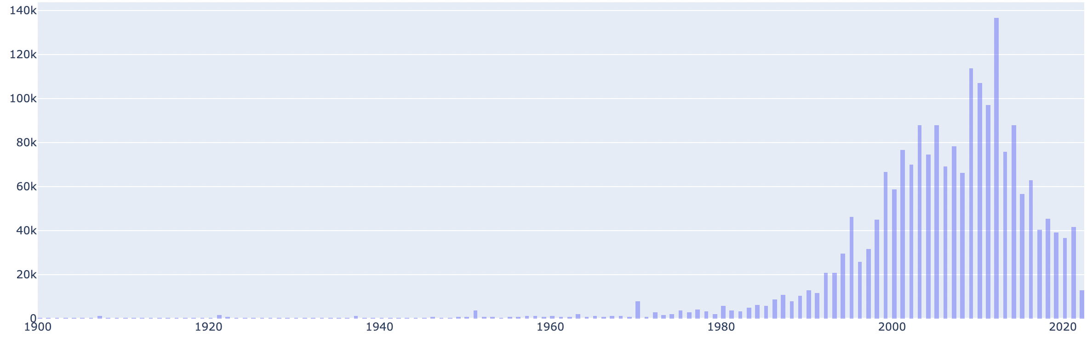
Count
Year
#Number of data per publication year.
Most of the publication were between 2000 and 2020

Slide 21
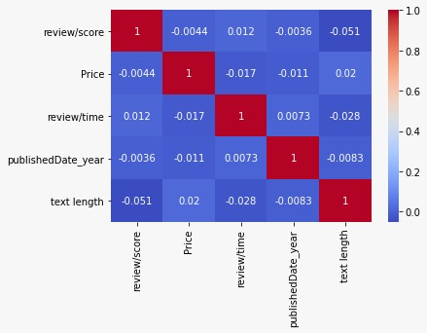
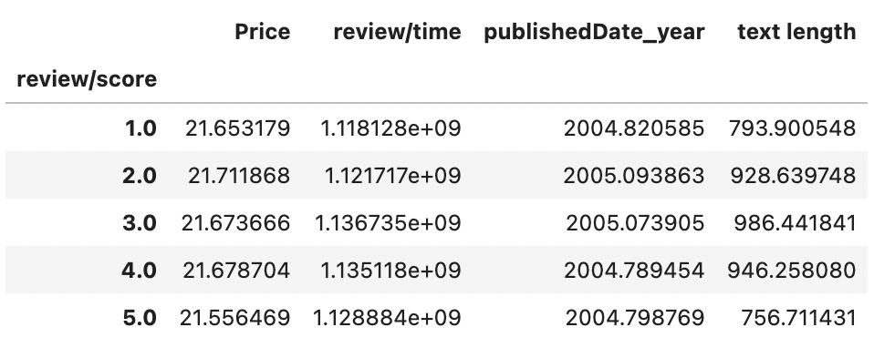
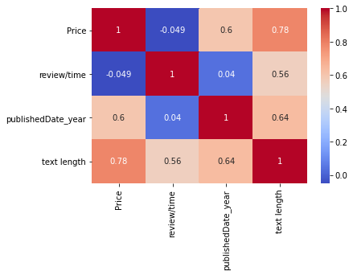
Correlation analysis
between 'review/score' and 'price', 'review/time' and 'text length'.

Slide 22
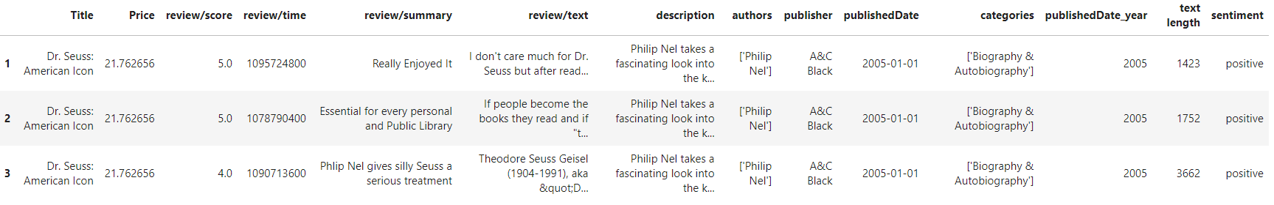
Classifying reviews
# In this study, a 'review/score' score higher than 3 was defined as a positive review, and a score of less or equal than 3 was defined as a negative review.
df['sentiment'] = ['positive' if x > 3 else 'negative' for x in df['review/score']]

Slide 23
Positive and negative word clouds
1. Since there are about 2 million data, we randomly selected 10,000 each of 'Positive' and 'Negative’.
df_Psample10000=df[df['sentiment']=='positive'].sample(n=10000)
df_Nsample10000=df[df['sentiment']=='negative'].sample(n=10000)
2. We created a stopword list to remove the words that don’t add meaning to a review
stops= set(STOPWORDS)
stops.update(["book", "read","one","story","time","quot","character","books","make"])
3. Creating the Word Clouds
textt_p = " ".join(x for x in df_Psample10000["review/text"])
wordcloud = WordCloud(stopwords=stops).generate(textt_p)
wordcloud.to_file("review_p.png")

Slide 24
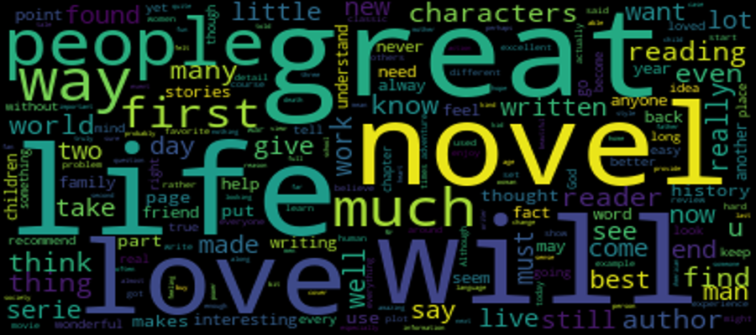
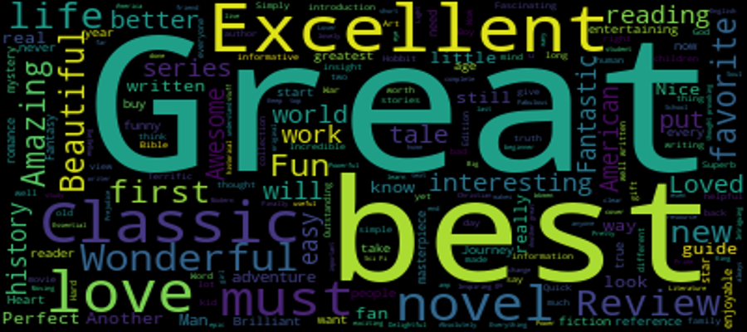
Positive Word Cloud
Based on the text of the review
Based on the summary of the review

Slide 25
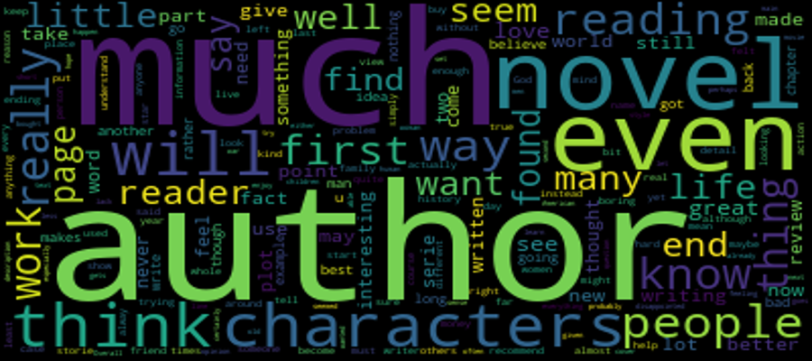
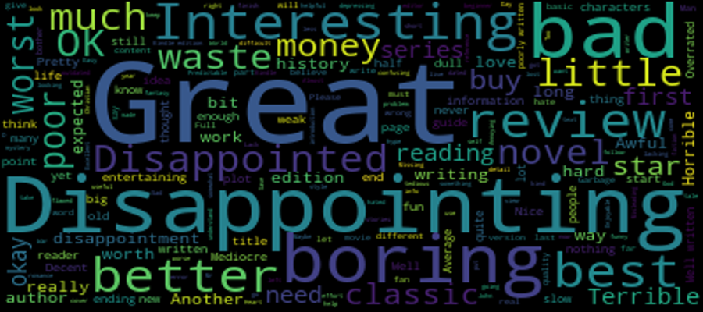
Negative Word Cloud
Based on the text of the review
Based on the summary of the review

Slide 26

Prediction

Slide 27
Prediction
3.1 Build a simple logistic regression model to predict the sentiment category based on a text-based review.
#Execution of required modules
import string
import re as re
import random as ran
import plotly
import matplotlib
import pandas as pd
import nltk as nltk
from nltk.corpus import stopwords
from sklearn.linear_model import LogisticRegression
from sklearn.feature_extraction.text import CountVectorizer
pd.set_option('display.max_columns', None)
pd.set_option('display.max_rows', None)

Slide 28
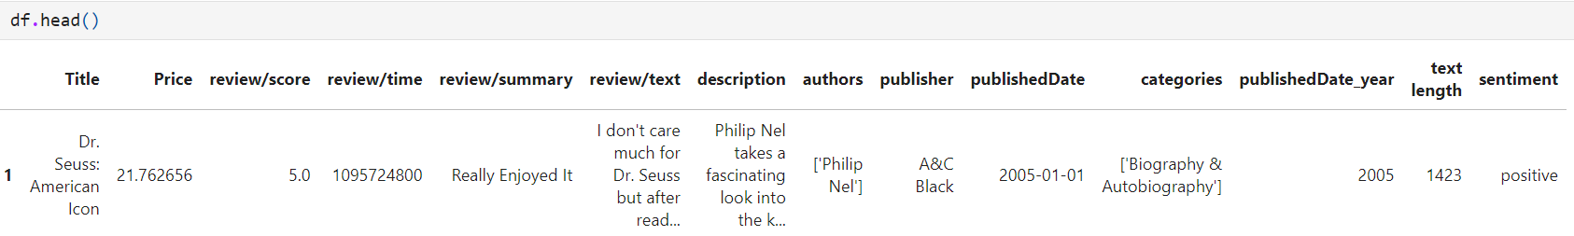
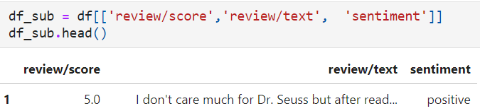
Prediction
#Test data cleansing step
def remove_punc_stopwords(text):
text = re.sub(f"[{string.punctuation}]"," ",text)
text_tokens = set(text.split())
text_tokens = text_tokens.difference(stops)
return " ".join(text_tokens)
#We randomly extracted 100000 pieces of data
df_sub_sample100000=df_sub.sample(n=100000)
#Remove punctuations and stopwords from the text data
df_sub_sample100000['review/text'] = df_sub_sample100000['review/text'].apply(remove_punc_stopwords)

Slide 29
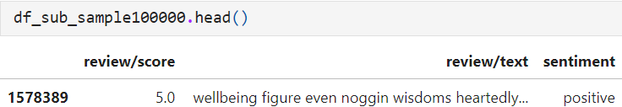
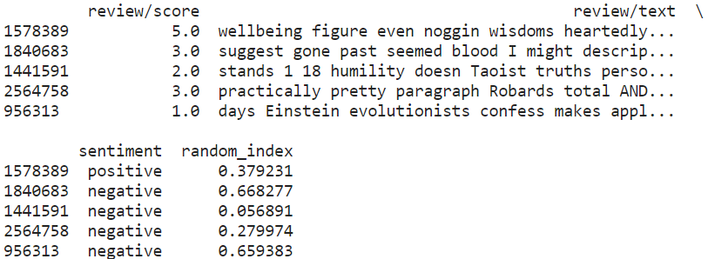
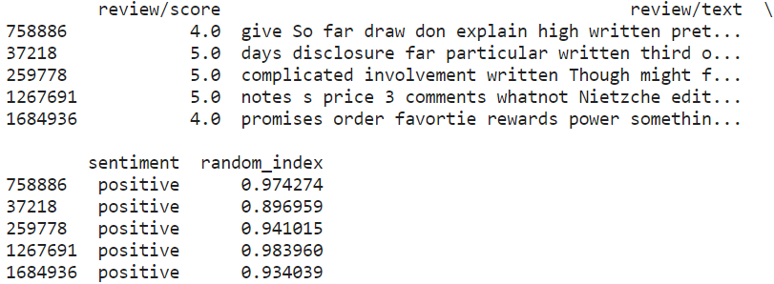
Prediction
# split the dataset into two: train (85% of the obs.) and test (15% of the obs.)
df_sub_sample100000['random_index'] =[ ran.uniform(0,1) for x in range(len(df_sub_sample100000))]
df_sub_train=df_sub_sample100000[df_sub_sample100000.random_index < 0.85]
df_sub_test=df_sub_sample100000[df_sub_sample100000.random_index >= 0.85]

Slide 30
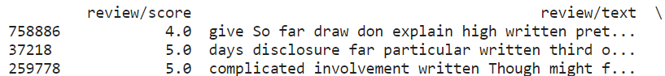
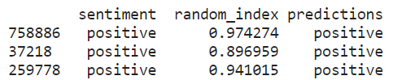
Prediction
#We used count vectorizer to transform the text into a 'bag of words' model, which will contain a sparse matrix of integers since the logistic regression algorithm cannot understand text
vectorizer = CountVectorizer(token_pattern=r'\b\w+\b')
train_matrix = vectorizer.fit_transform(df_sub_train['review/text'])
test_matrix = vectorizer.transform(df_sub_test['review/text'])
#Generate the predictions for the test dataset
predictions = lr.predict(X_test)
df_sub_test['predictions'] = predictions
print(df_sub_test.head(30))
#Perform Logistic Regression
lr = LogisticRegression(solver='liblinear')
X_train = train_matrix
X_test = test_matrix
y_train = df_sub_train['sentiment']
y_test = df_sub_test['sentiment']
lr.fit(X_train,y_train)

Slide 31
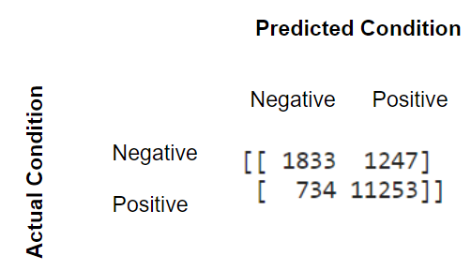
Prediction
#Calculate the prediction accuracy
df_sub_test['match'] = df_sub_test['sentiment'] == df_sub_test['predictions']
print(sum(df_sub_test['match'])/len(df_sub_test))
#We created a good model with about 87% accuracy
0.8685206079511515
#We can use SciKit Learn's built-in confusion matrix to give us a better idea of what our classification model is getting right and what types of errors it is making.
from sklearn.metrics import confusion_matrix
print(confusion_matrix(y_test,predictions))
1833 Negative numbers were correctly predicted as Negative.
1247 Negative numbers were incorrectly predicted as Positive.
734 Positive numbers were incorrectly predicted as Negative. 11253 Positive numbers were correctly predicted as Positive.
1833 + 11253 / (1833 + 1247 + 734 + 11253) = 0.8685206079511515(accuracy)

Slide 32
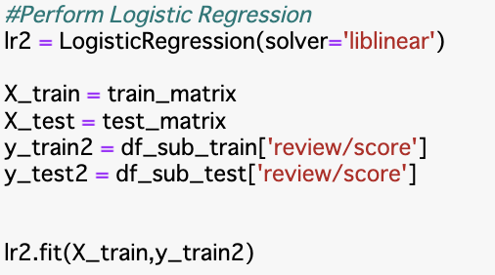
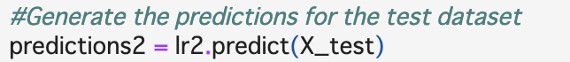
Prediction
Building a multinomial logistic regression model to predict the rating of a book.
・Creating a logistic model
~Predicted Target ~
‘review/score’ [1,2,3,4,5]

Slide 33
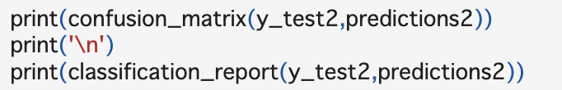
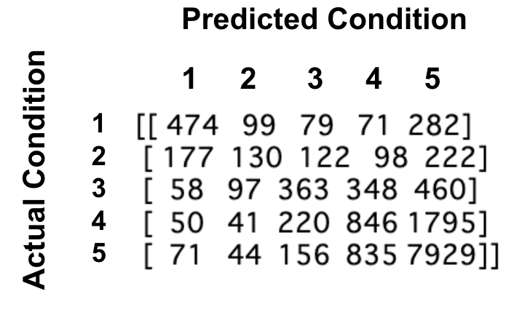
Prediction
#classification context
>>> Output
#The accuracy of logistic model
As expected, the prediction accuracy was lower than the Simple logistic regression model because the prediction target 'review/score' also has five categories.
#We created a model with about 65% accuracy
0.6465786155173558

